Slide 1

WQF7023 Artificial Intelligence Research Project 2
2025/2026 Semester 1
Explainable Demand Forecasting for Retailers using Graph Neural Networks and Temporal Fusion Transformers
Supervisor: ASSOCIATE PROF.TS.DR.Aznul Qalid Bin MD Sabri
Student: 23115588 Maksatbek kyzy Aizhan

Slide 2
Introduction
Research Questions and Research Objectives
Temporal Fusion Transformer
Spatio-Temporal Graph Neural Network
Hybrid GNN-TFT
Summary
Content of the Presentation

Slide 3

Introduction
Demand forecasting is central to retail success, enabling efficient inventory and resource management.
Complex supply chains and logistics increase the need for advanced, AI-driven forecasting models.
This research explores GNN, TFT, hybrid GNN-TFT models, prioritizing both predictive accuracy and model explainability.
Explainable AI builds trust and transparency, ensuring retail stakeholders can understand and act on model insights.

Slide 4

Research Questions and Objectives
1
2
3
Which approach yields higher accuracy in retail demand forecasting: GNN, TFT, or a hybrid GNN-TFT model?
To evaluate and compare the forecasting accuracy of GNN, TFT, and hybrid GNN-TFT models.
Which features within the retail dataset have the greatest and least impact on the predictive accuracy of these models?
To interpret model predictions by applying both model-specific and model-agnostic explainable AI (XAI) methods.
What architectural improvements are most effective for optimizing the performances of models?
To find and implement architectural improvements, aiming to maximize predictive performance and operational value of models.

Slide 5
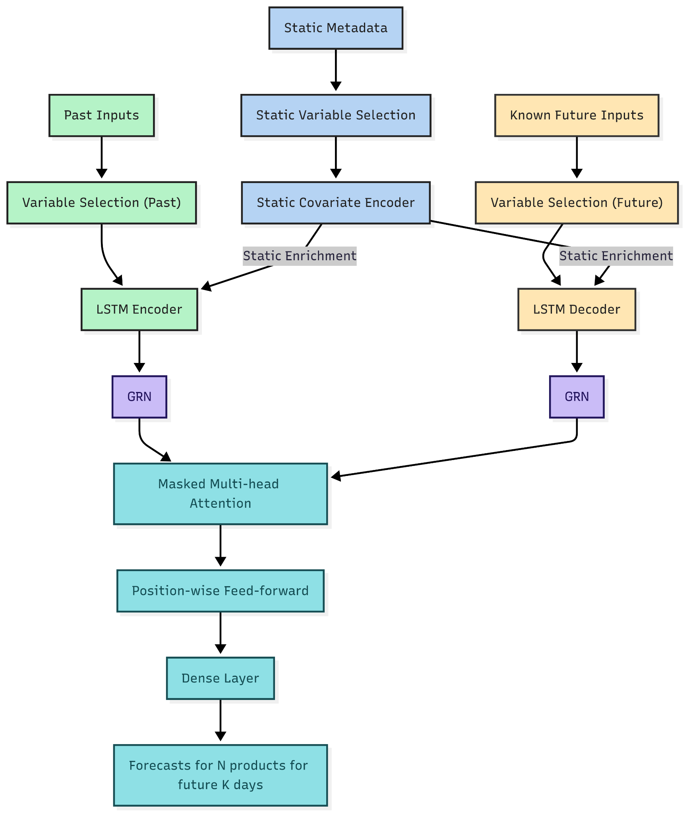
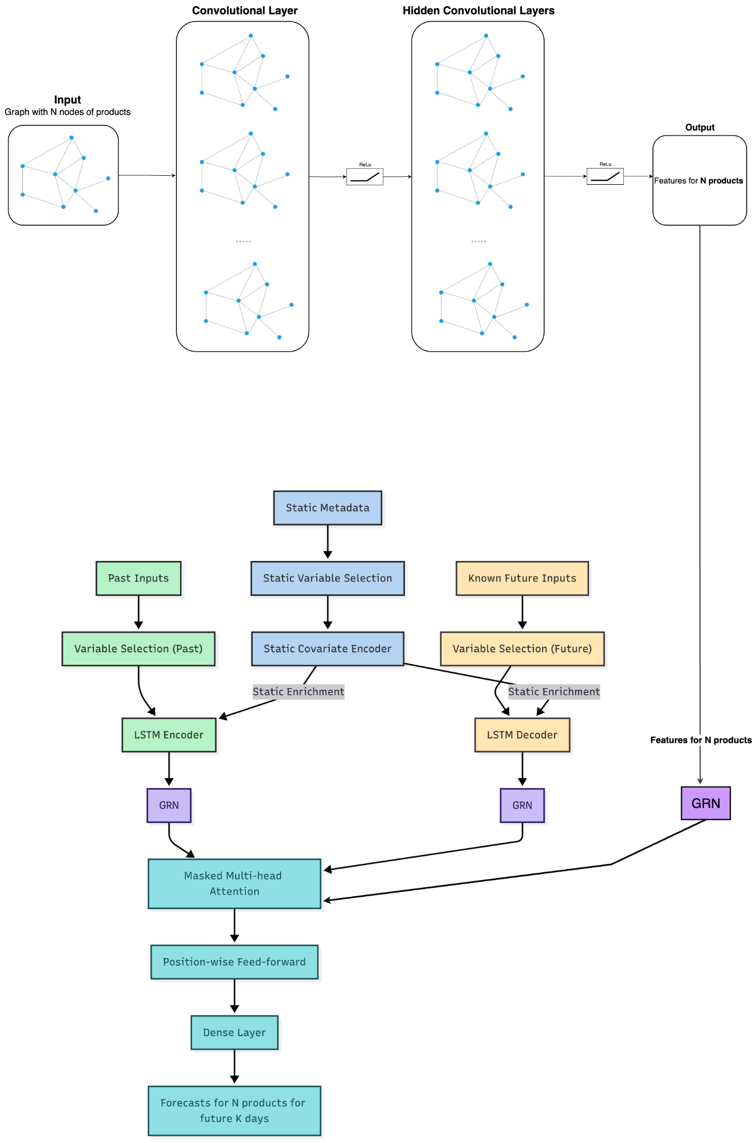
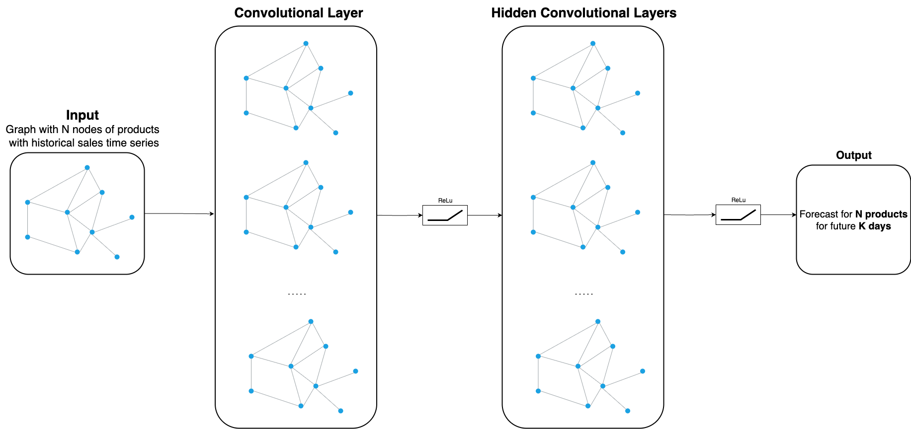
Model Architectures
TFT
Hybrid GNN-TFT
GNN

Slide 6
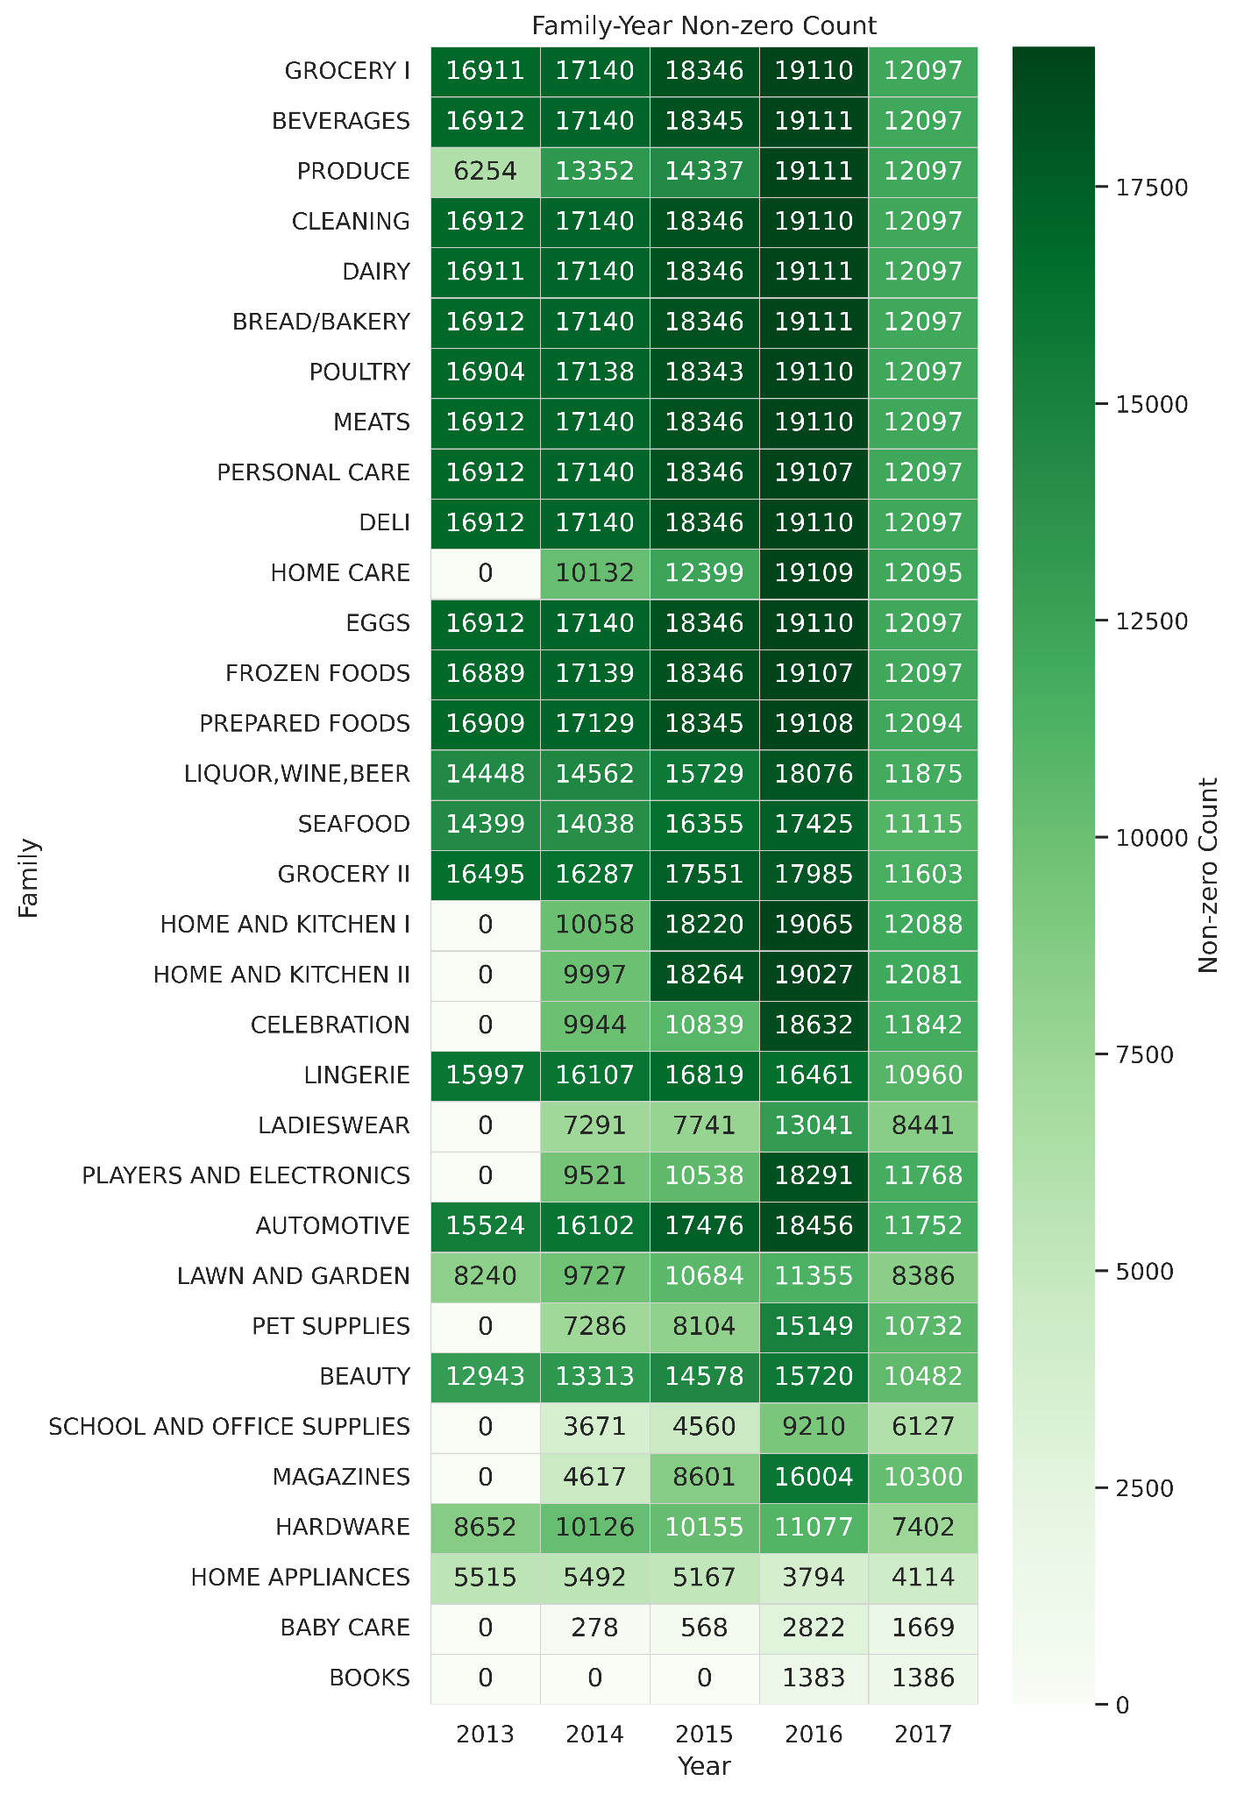
33 - product families
54 - stores
5 - store types
17 - store clusters
22 - states
Data - Favorita Grocery
grocery and household have high daily non-zero sales from 2013 to 2016, with a peak in 2016 and a drop in 2017
home care, baby care and books either started later or have much sparser sales

Slide 7

Results
Temporal Fusion Transformers
Spatio-Temporal Graph Neural Networks
Hybrid GNN-TFT

Slide 8
1
Temporal Fusion Transformer

Slide 9
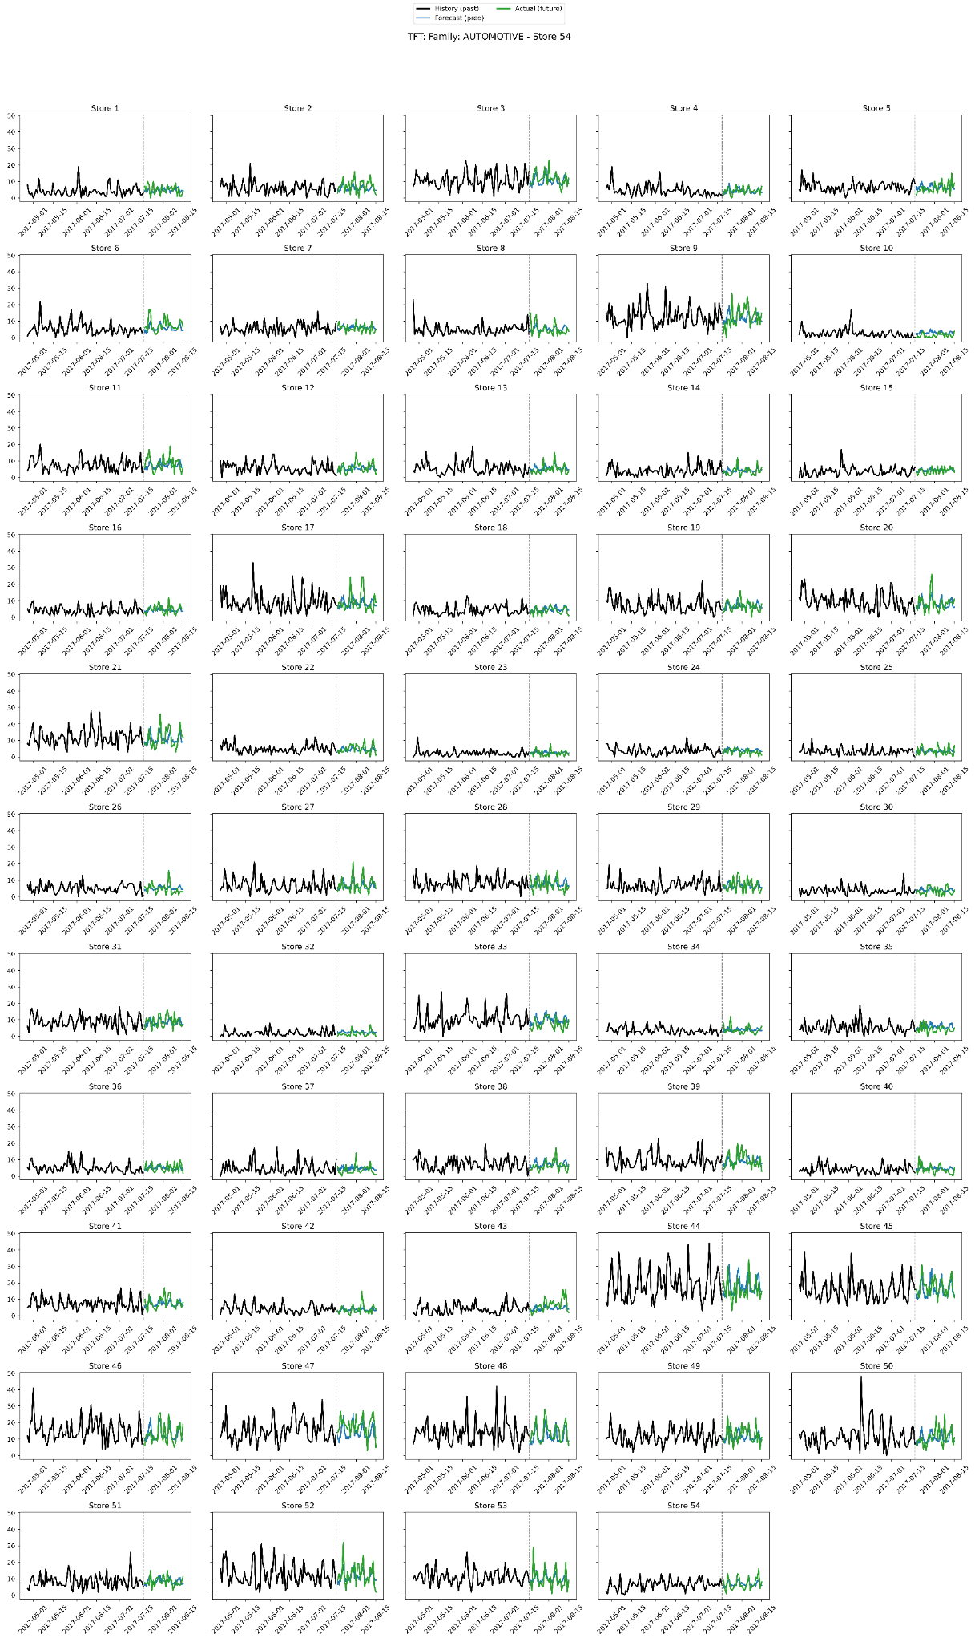
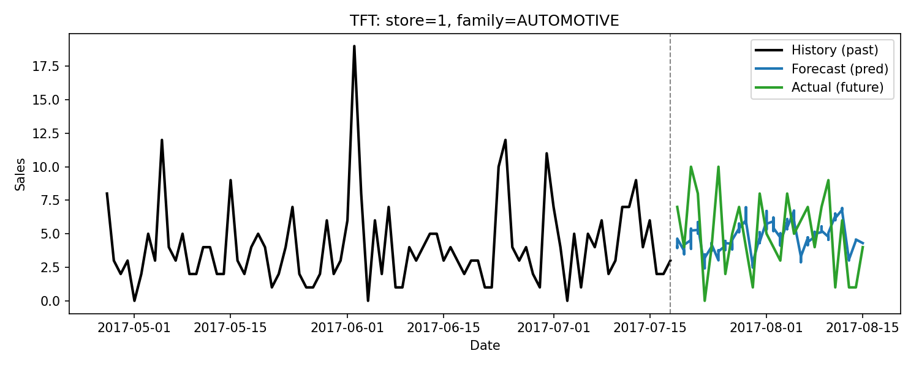
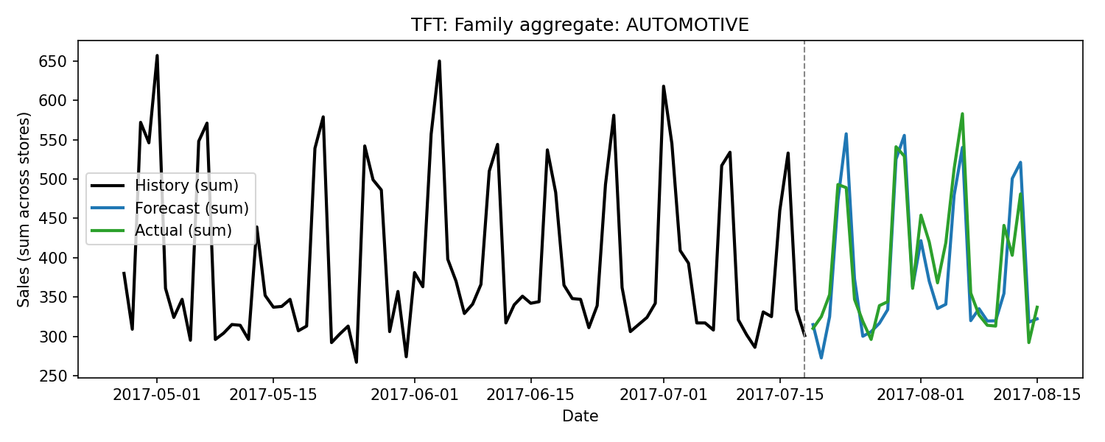
Temporal Fusion Transformer

Slide 10
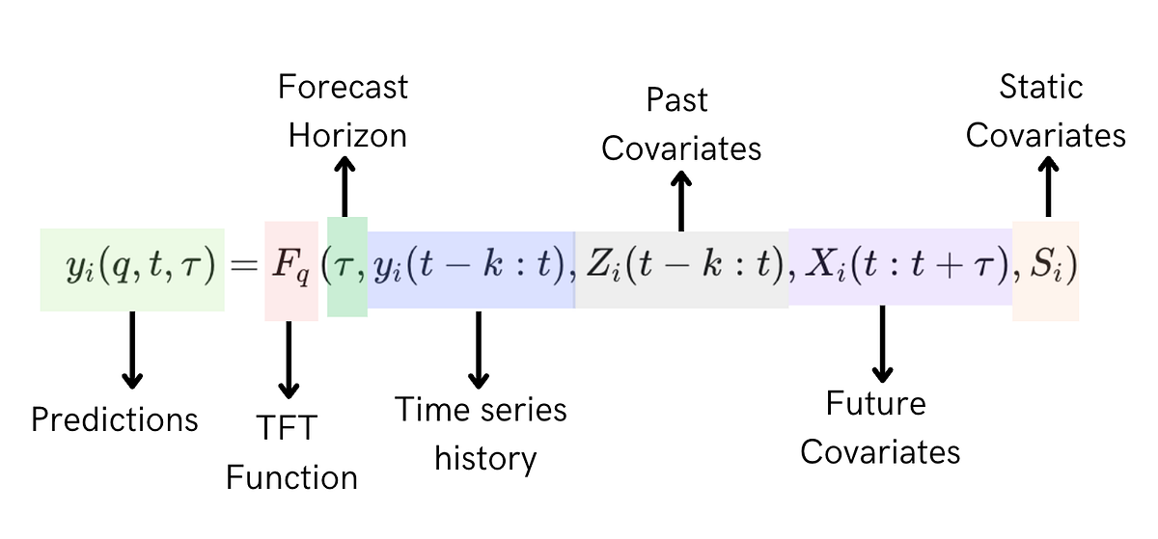
TFT Input Data
Image Reference: Medium
Feature Category | Feature Name
Past observed (9 total) | sales transactions daily oil price promotion day of the week month week of the year holiday workday
Known future (6 total) | promotion day of the week month week of the year holiday workday
Static (4 total) | store number product family store state store cluster

Slide 11

XAI

Slide 12
Model-Agnostic Method
Permutation Importance
Space | Variable | ΔWAPE
Decoder (future) | onpromotion | 0.1053
 | dow | 0.0216
 | month | 0.0130
 | weekofyear | 0.0107
 | is_holiday | 0.0024
 | is_workday | 0
Encoder (historical) | sales | 0.0280
 | transactions | 0.0020
 | onpromotion | 0.0018
 | is_holiday | 0.0002
 | dow | 0.0001
 | is_workday | 0
 | weekofyear | -0.0001
 | month | -0.0004
 | dcoilwtico | -0.0016
Static | state | ~0
 | cluster | ~0
 | family | ~0
 | store_nbr | ~0

Slide 13
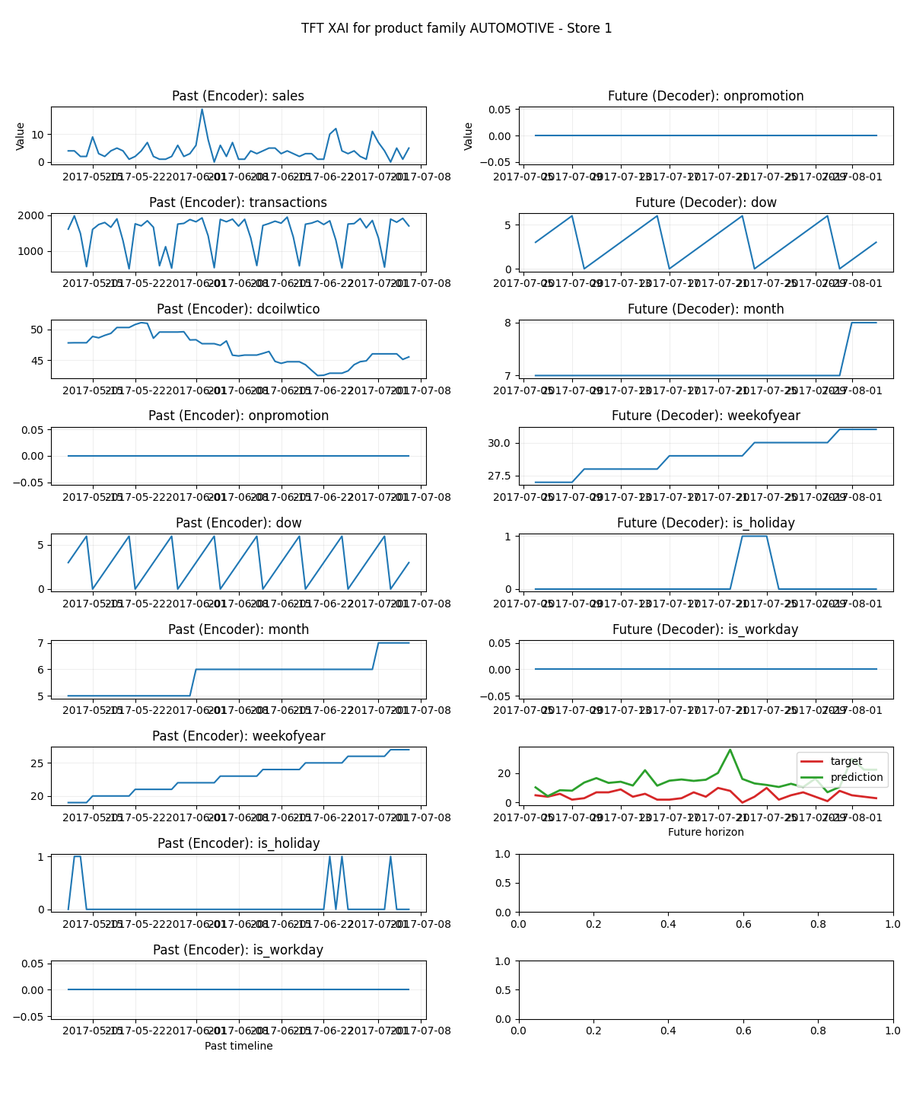
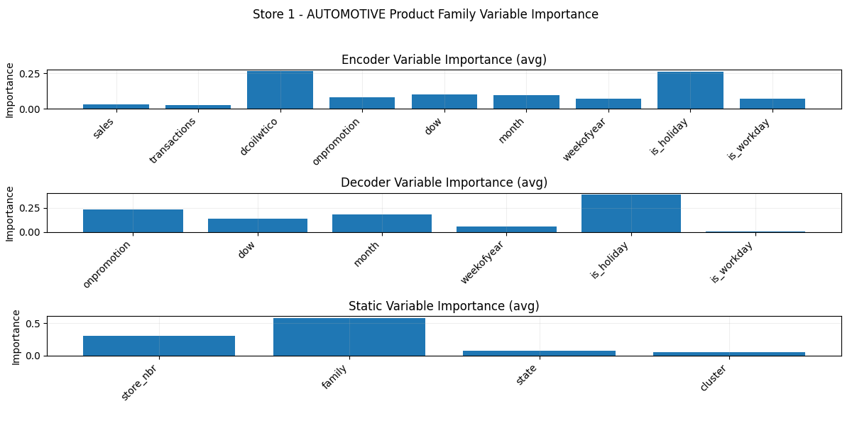
Model-Intrinsic Method
Attention and Variable Selection Weights

Slide 14
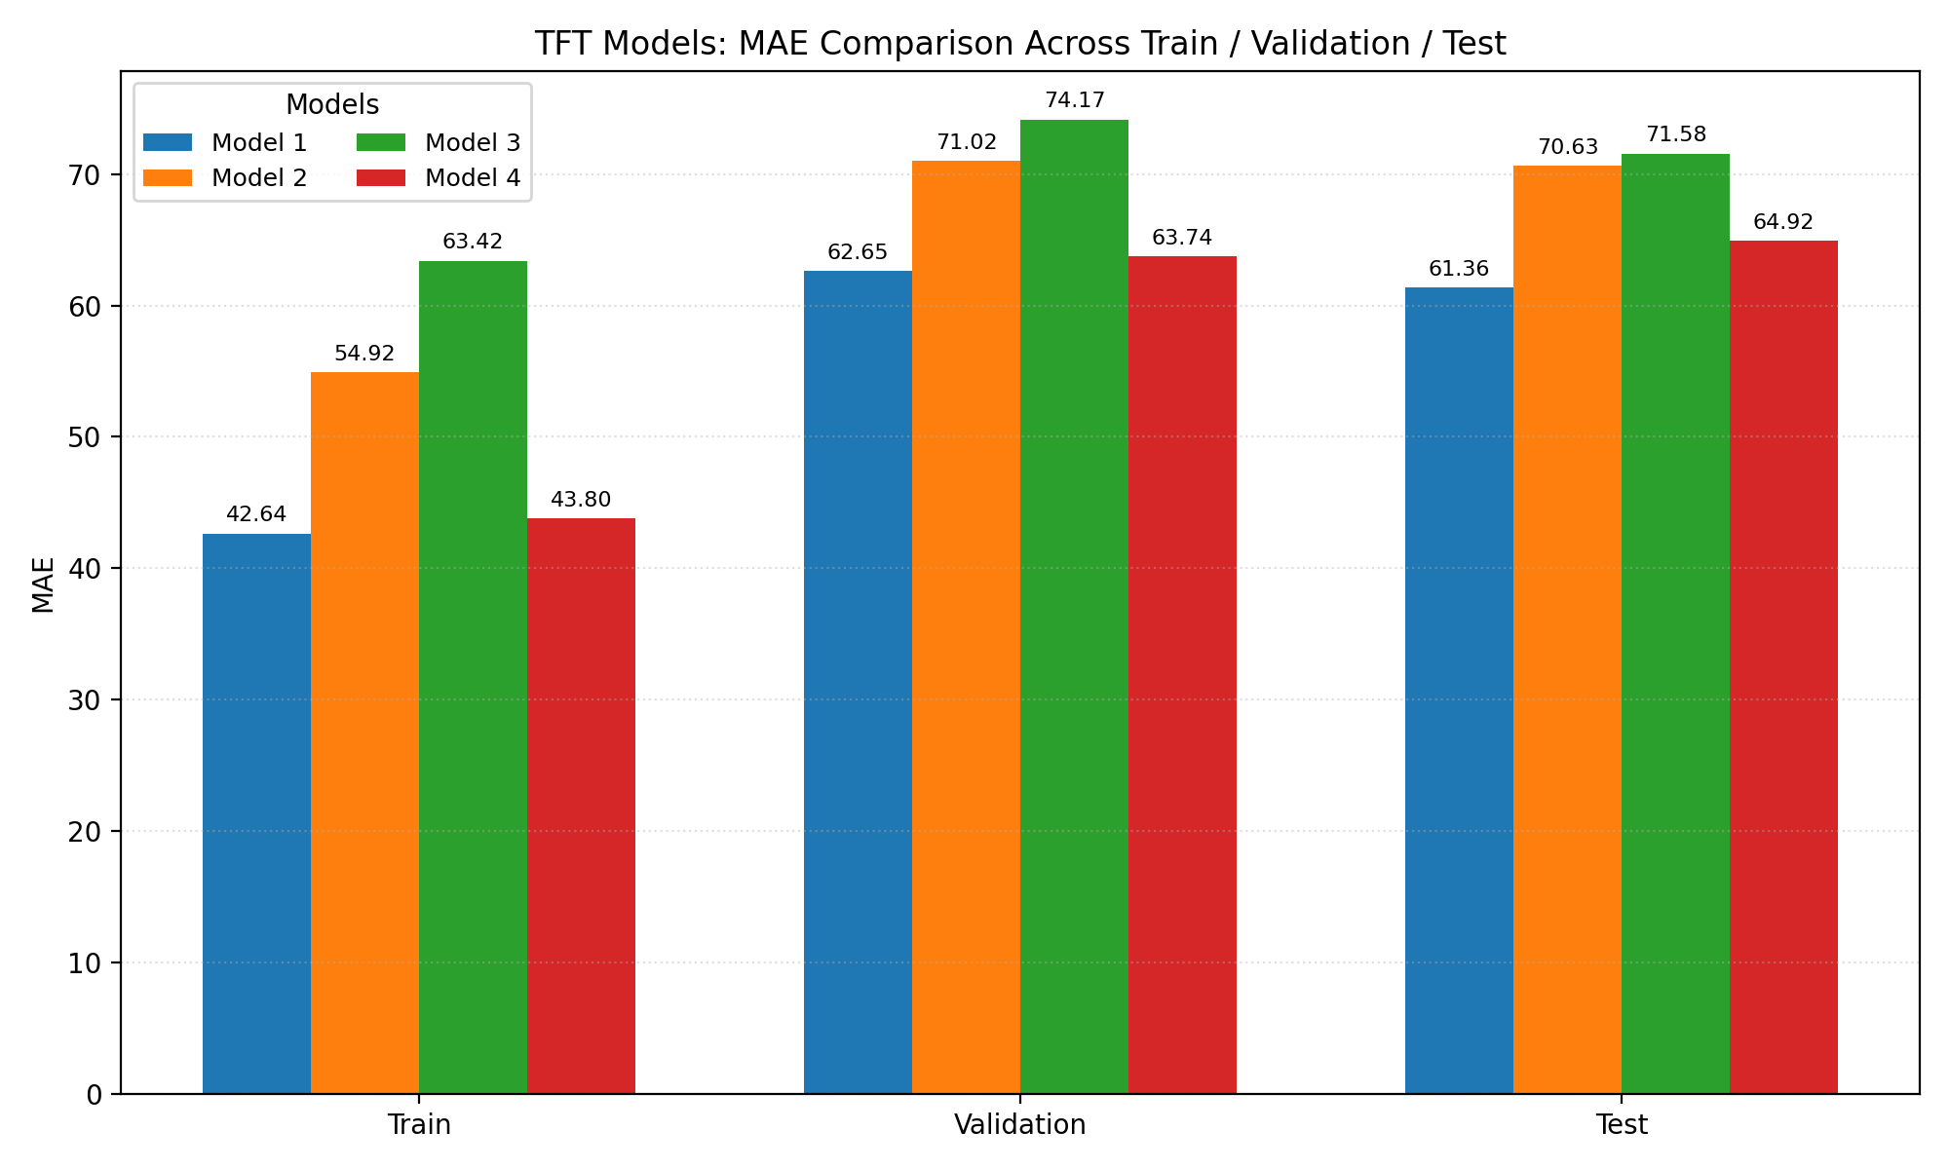
Parameters
--hidden-dim: 128 --d-model: 64 --heads: 4 --lstm-hidden: 64 --lstm-layers: 1 --dropout: 0.1
--hidden-dim: 64 --d-model: 32 --heads: 2 --lstm-hidden: 32 --lstm-layers: 1 --dropout: 0.1
--hidden-dim: 32 --d-model: 16 --heads: 2 --lstm-hidden: 16 --lstm-layers: 1 --dropout: 0.1
--hidden-dim: 256 --d-model: 128 --heads: 8 --lstm-hidden: 128 --lstm-layers: 1 --dropout: 0.3
Model Performance

Slide 15
2
Spatio-Temporal Graph Neural Network (STGNN)

Slide 16
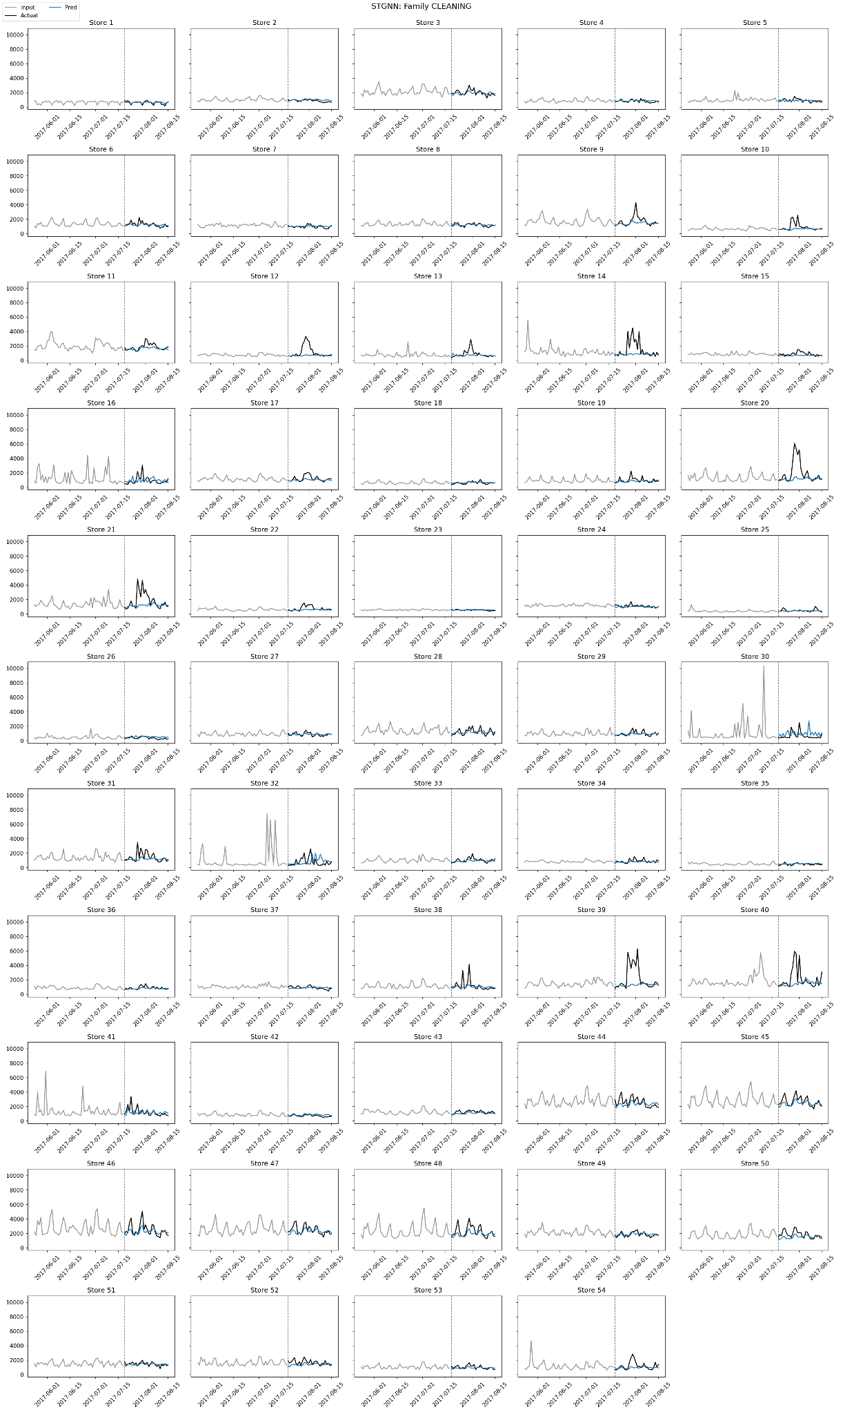
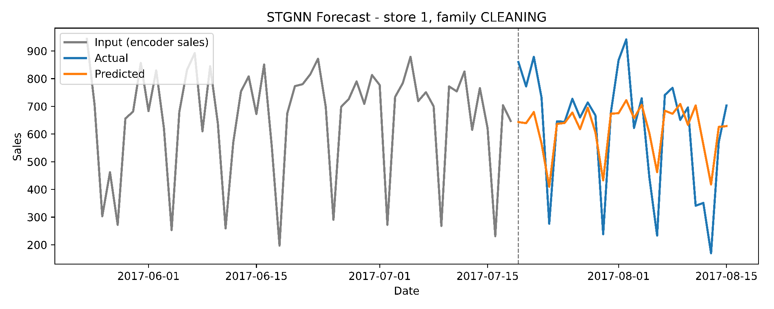
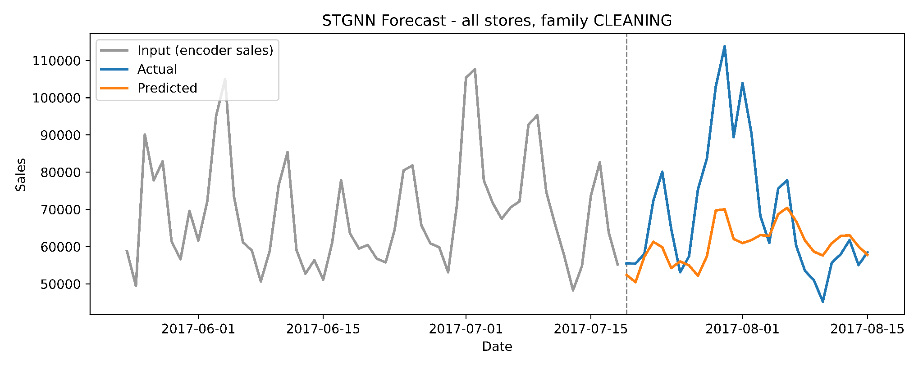
Spatio-Temporal Graph Neural Network

Slide 17
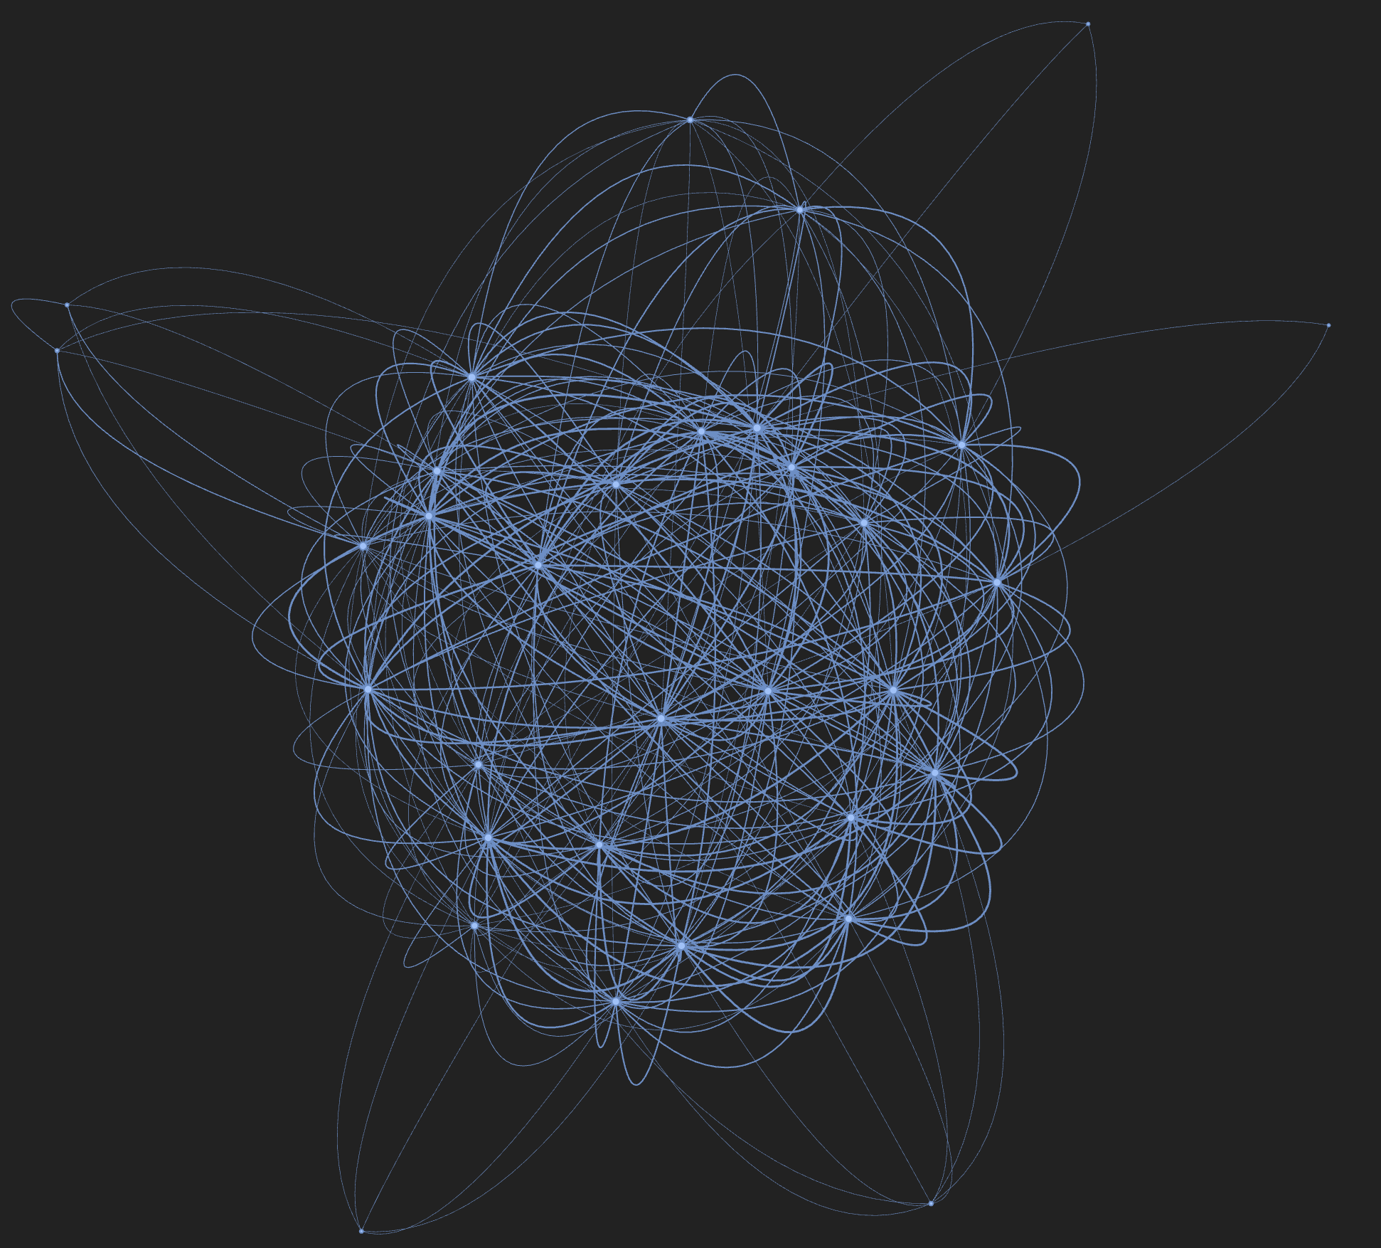
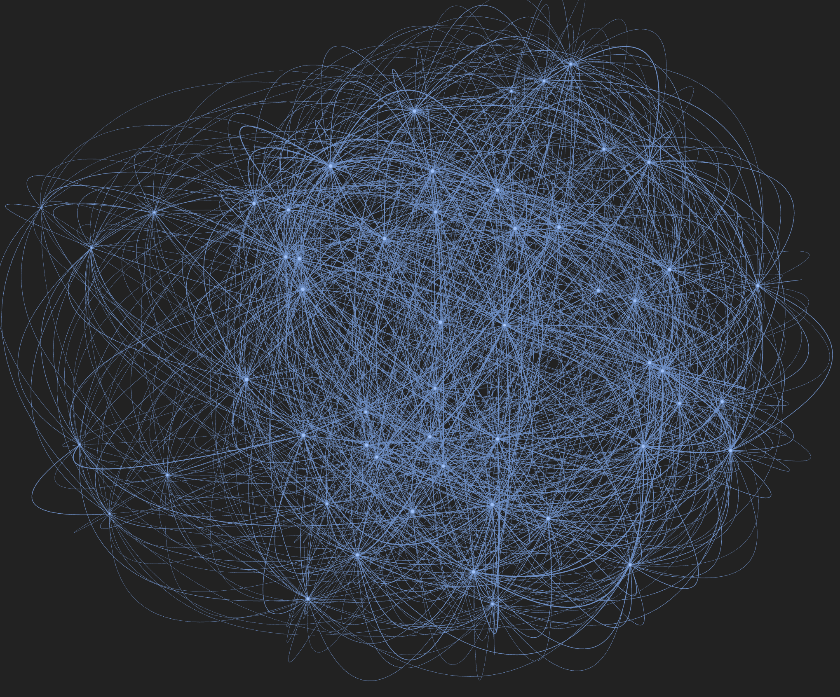
STGNN Data
T - Dates
N - Nodes (distinct pairs of store and family)
F - Feature columns
Figure 6.2.3.1 Store Graph illustration
Figure 6.2.4.1 Product-Family Graph

Slide 18
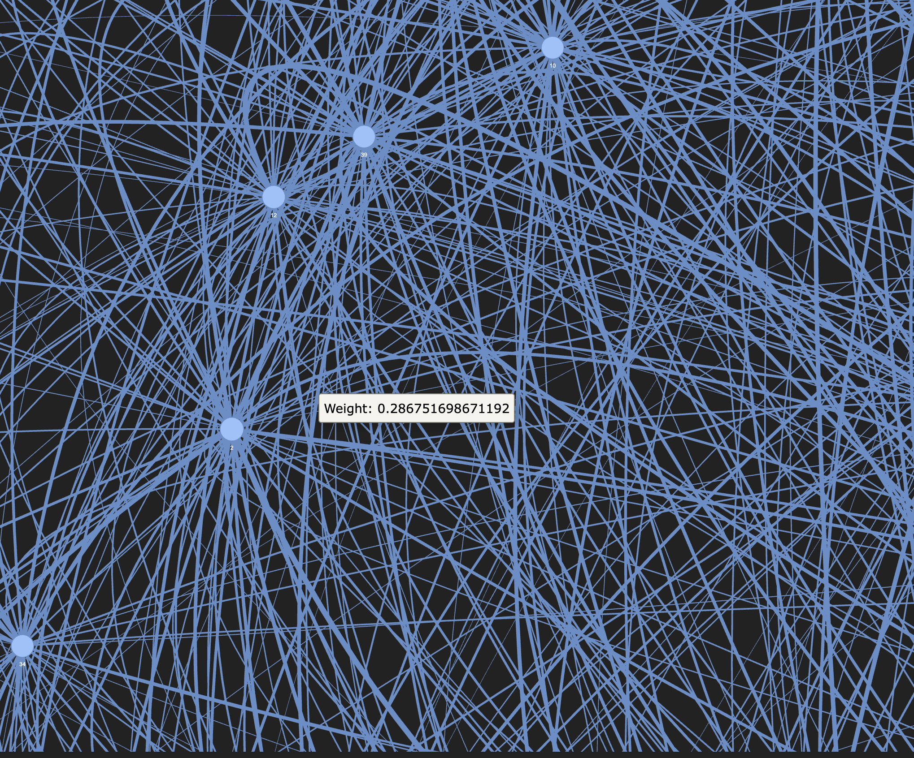
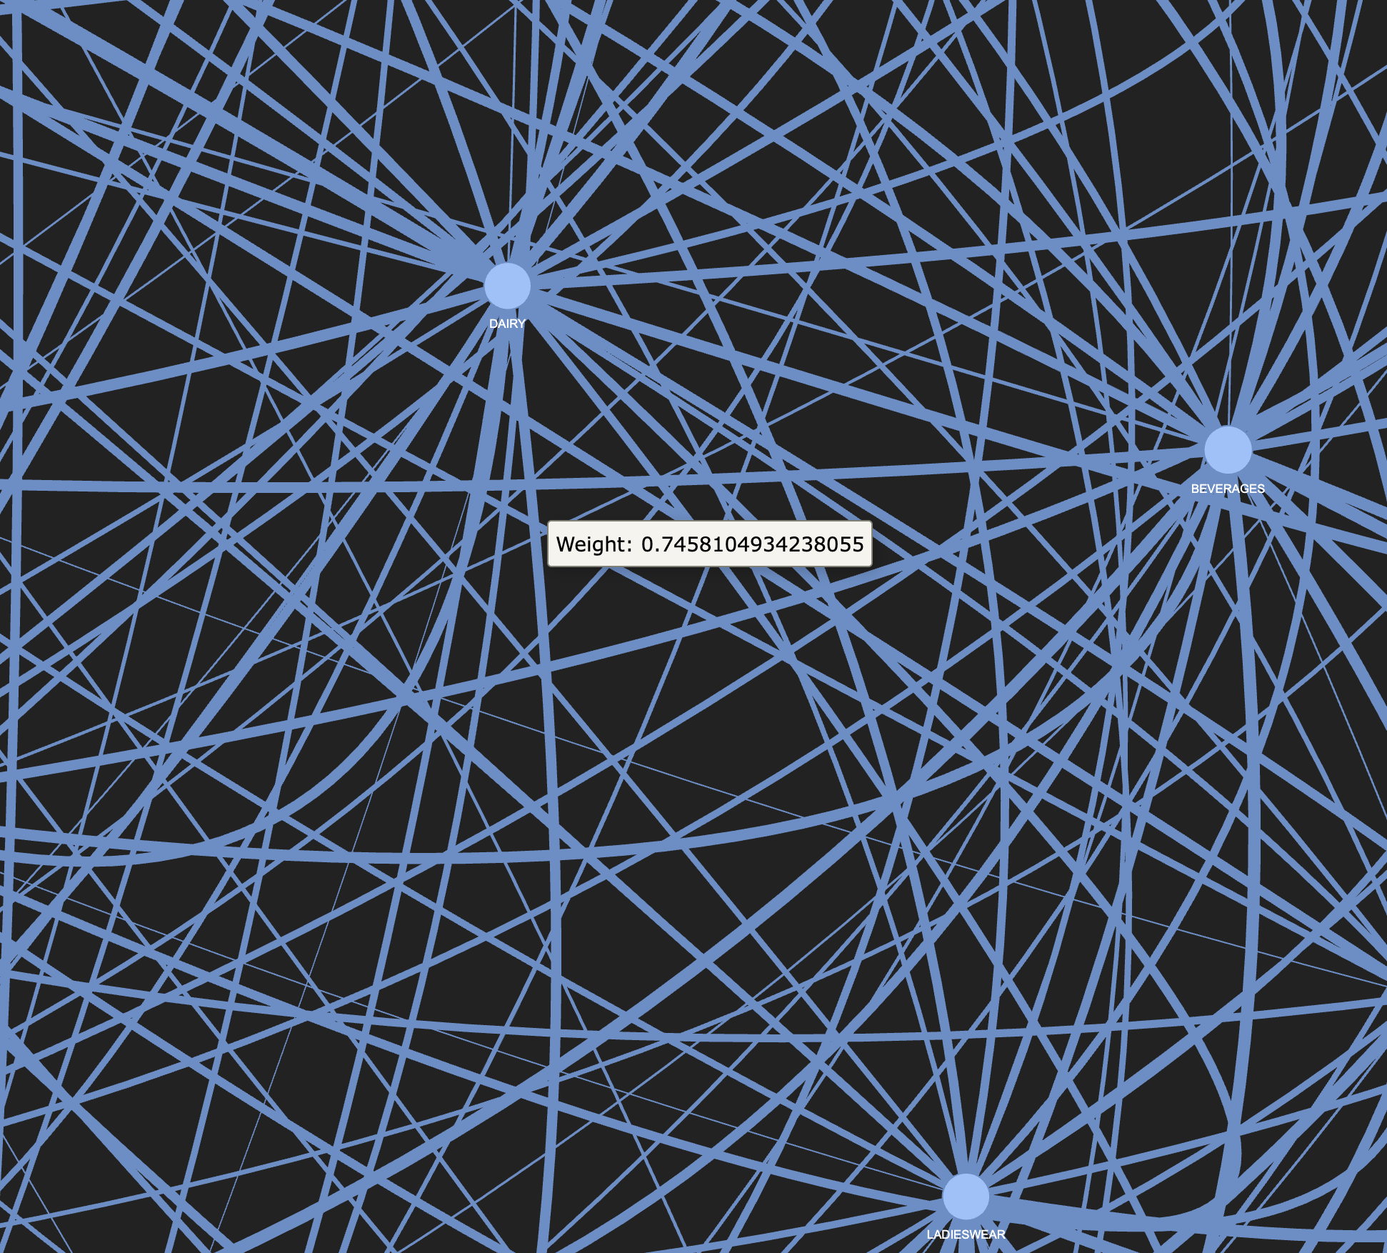
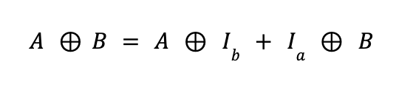
Store Graph
Family Graph
+0.5: if both stores belong to the same cluster
+0.3: if both stores are in the same state
+corr(transactions_a, transactions_b): Pearson correlation of the transaction time series
Pearson correlation coefficient is computed over a 60-day sales window for products (i) and (j)
If the correlation coefficient exceeds 0.3, an undirected edge is established between product (i) and (j), with the correlation value assigned as the weight
Kronecker-Sum

Slide 19
XAI

Slide 20
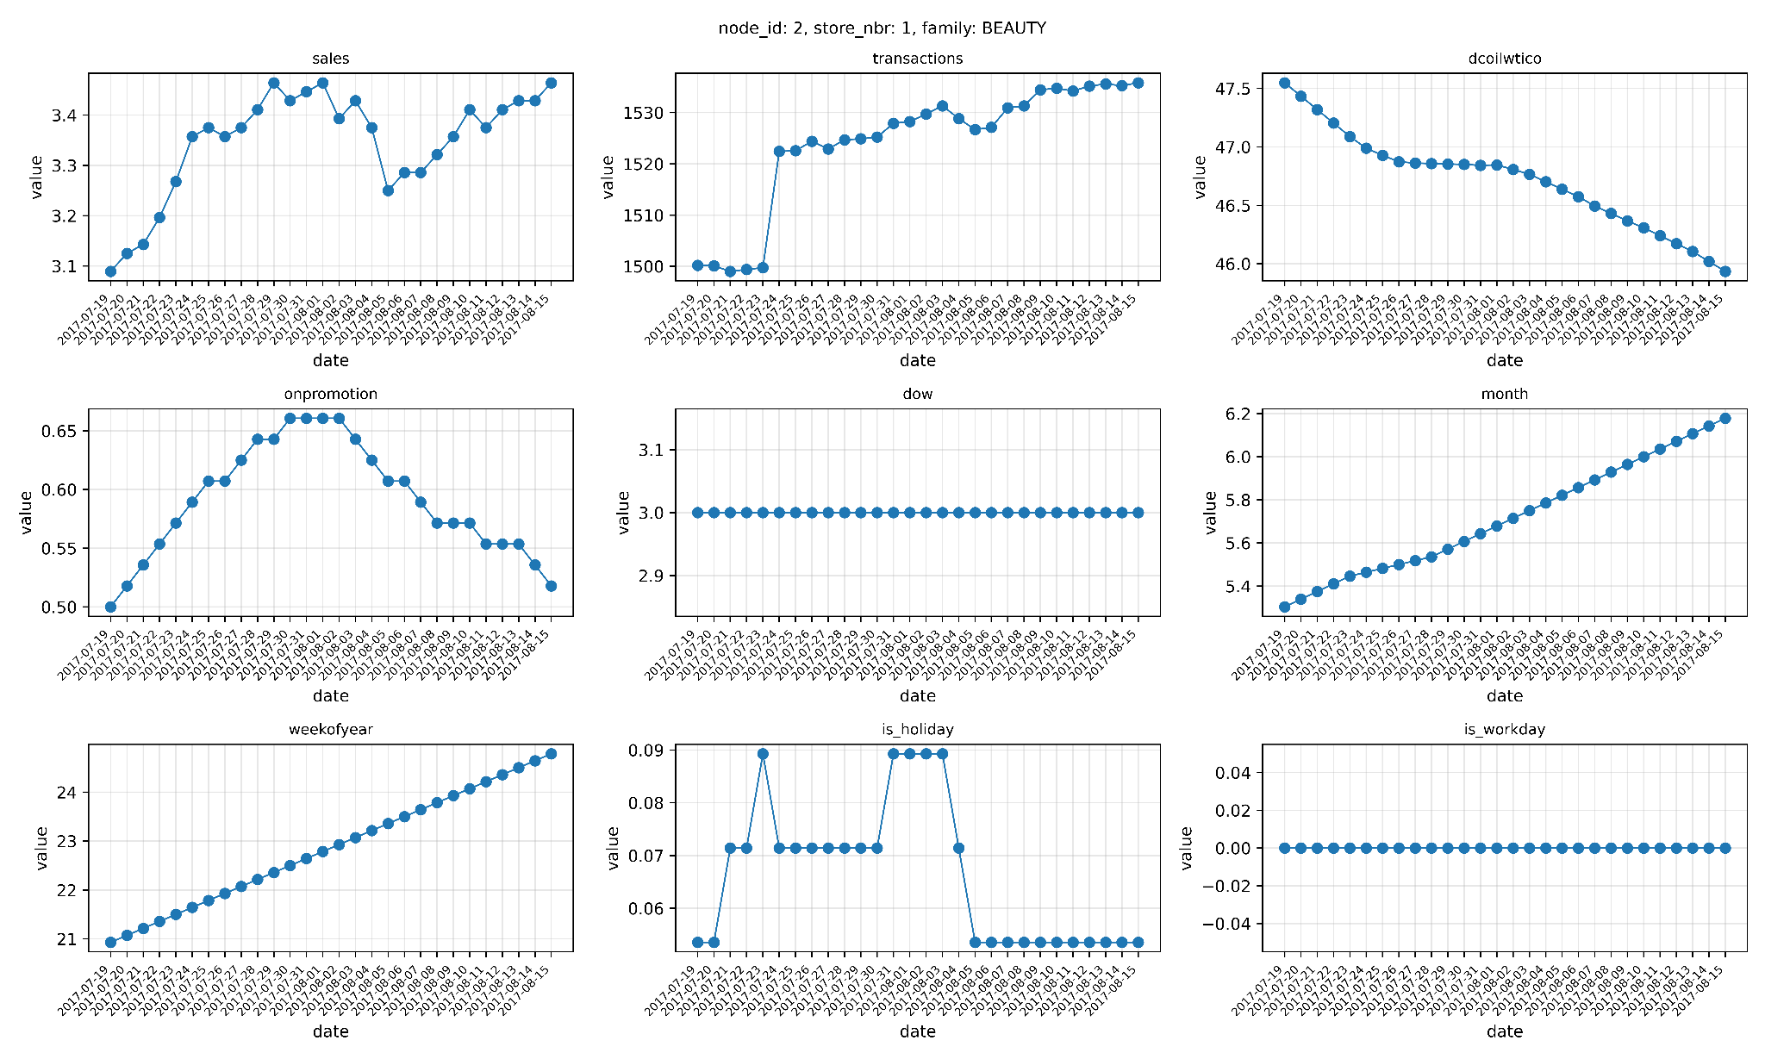
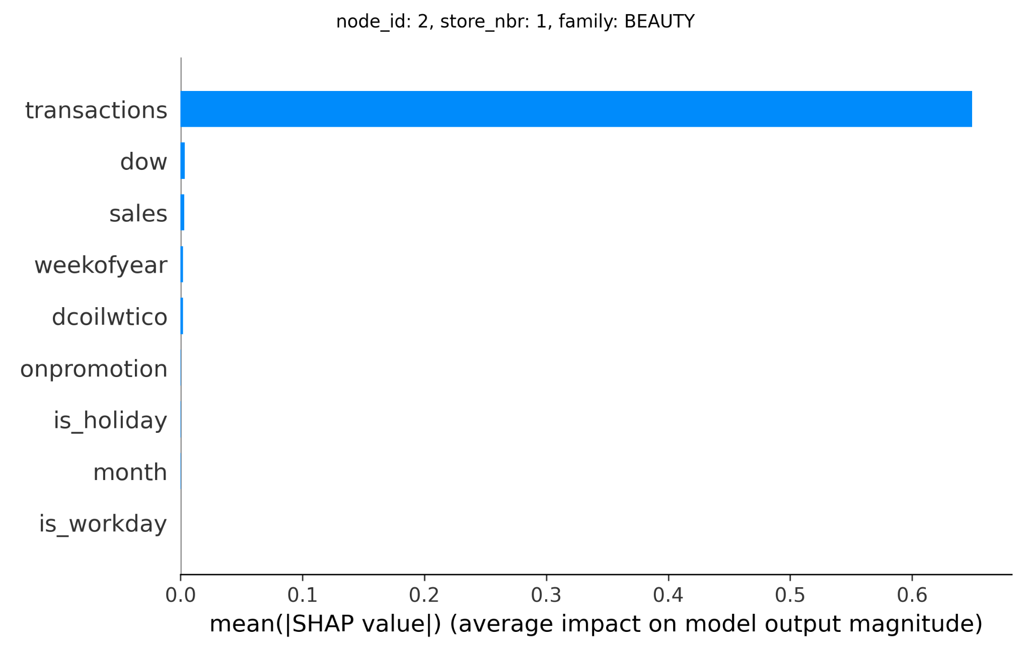
Feature-Level XAI: SHAP DeepExplainer
Feature | Mean absolute Shapley value
transactions | 0.6492
dow | 0.0033
sales | 0.0031
weekofyear | 0.0021
dcoilwtico | 0.0020
onpromotion | 0.0002
is_holiday | 0.0002
month | 0.0002
is_workday | 0.0

Slide 21
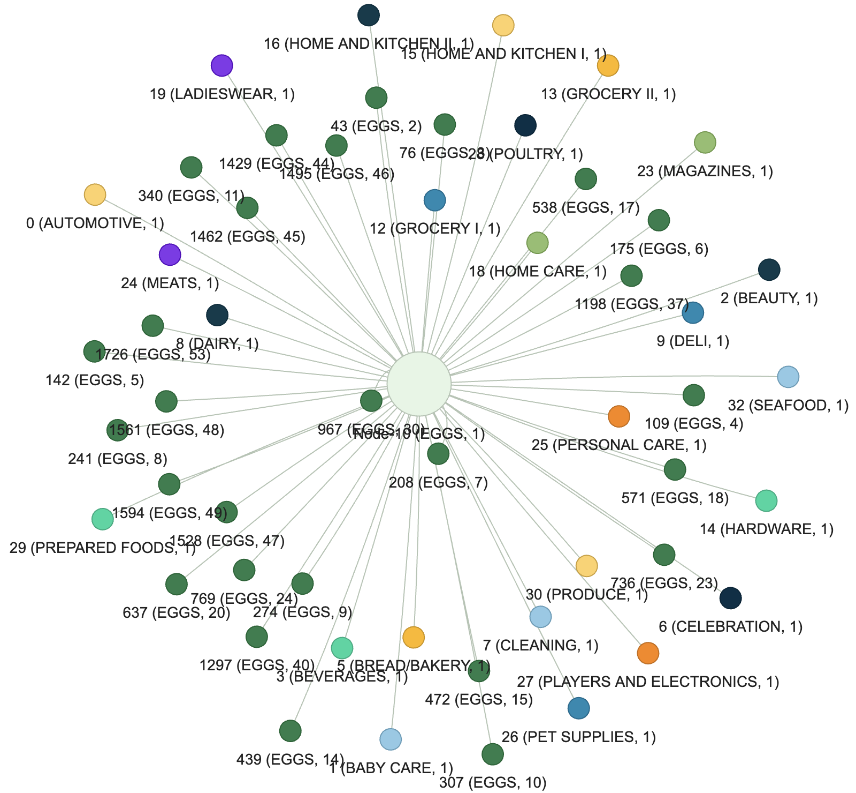
Structure-Level XAI
Custom Edge-Mask Explainer
Decision Influencing Neighbours

Slide 22
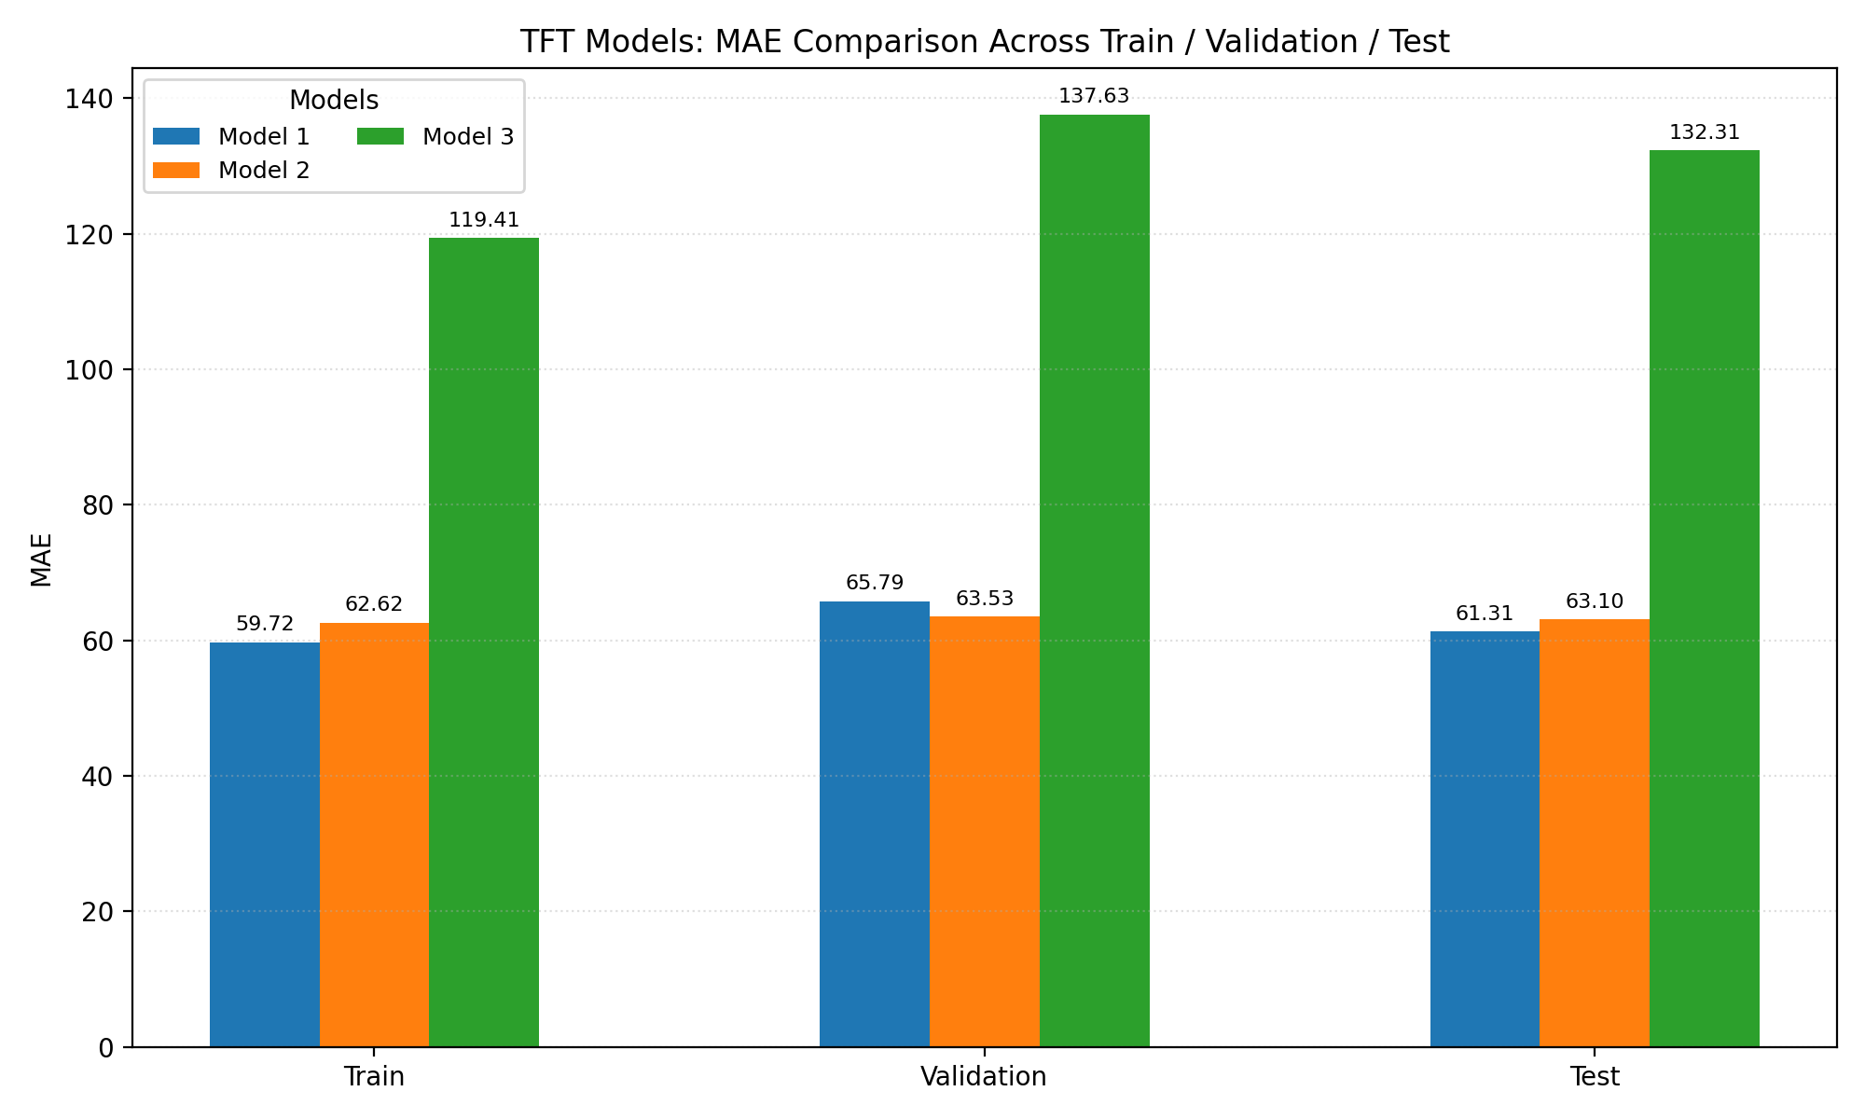
Performance
Parameters
--hidden: 64 --blocks: 3 --kernel: 3
--hidden: 32 --blocks: 3 --kernel: 3
--hidden: 16 --blocks: 1 --kernel: 1
Note from computational standpoint: configuring the model with hidden size of 128 or greater leads to GPU A100 memory allocation errors. Consequently, the model’s hidden size is restricted to the maximum feasible model capacity within the available computational resources.

Slide 23
3
Hybrid GNN-TFT

Slide 24
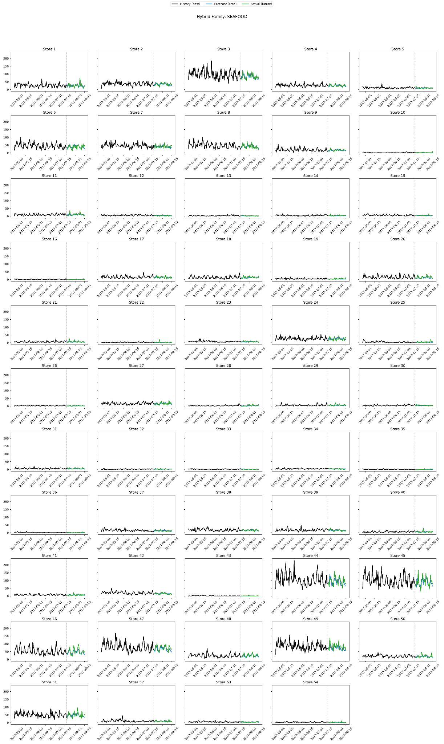
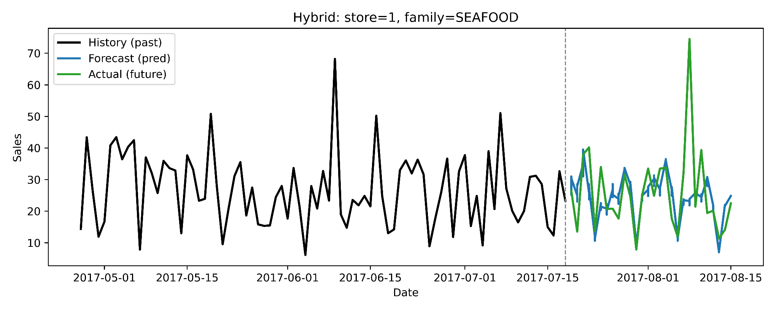
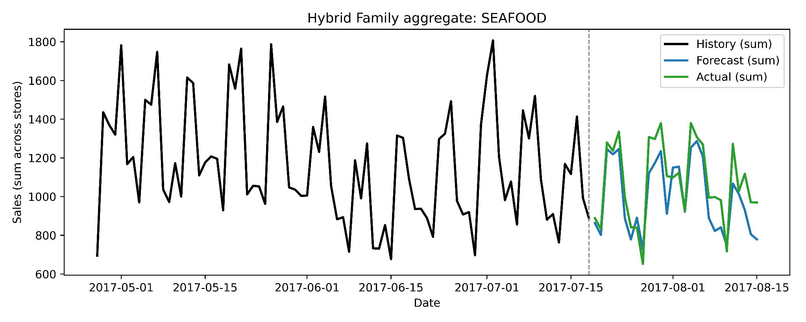
Hybrid Model

Slide 25
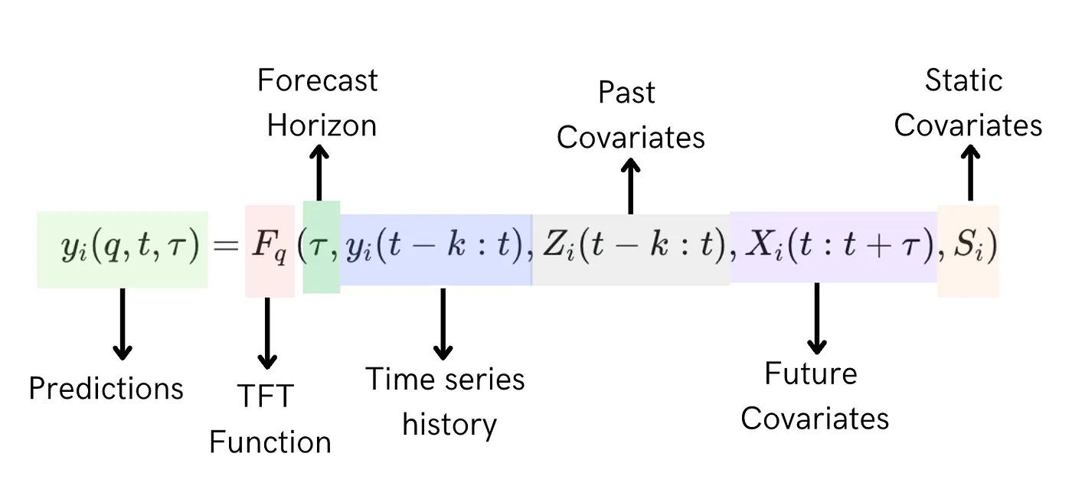
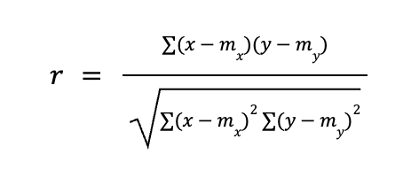
Hybrid Model Data
Exploits both relational and temporal patterns in the input data
Composed of two primary components: (1) Relational Encoder and (2) TFT
The RE employs a GNN to create node embeddings, thereby capturing the relational structure among product family and store number entities.
The node embeddings are concatenated with static input features, and then passed to the TFT block static covariate.
Node embeddings creation comprises the Pearson correlation coefficient computation

Slide 26
XAI

Slide 27
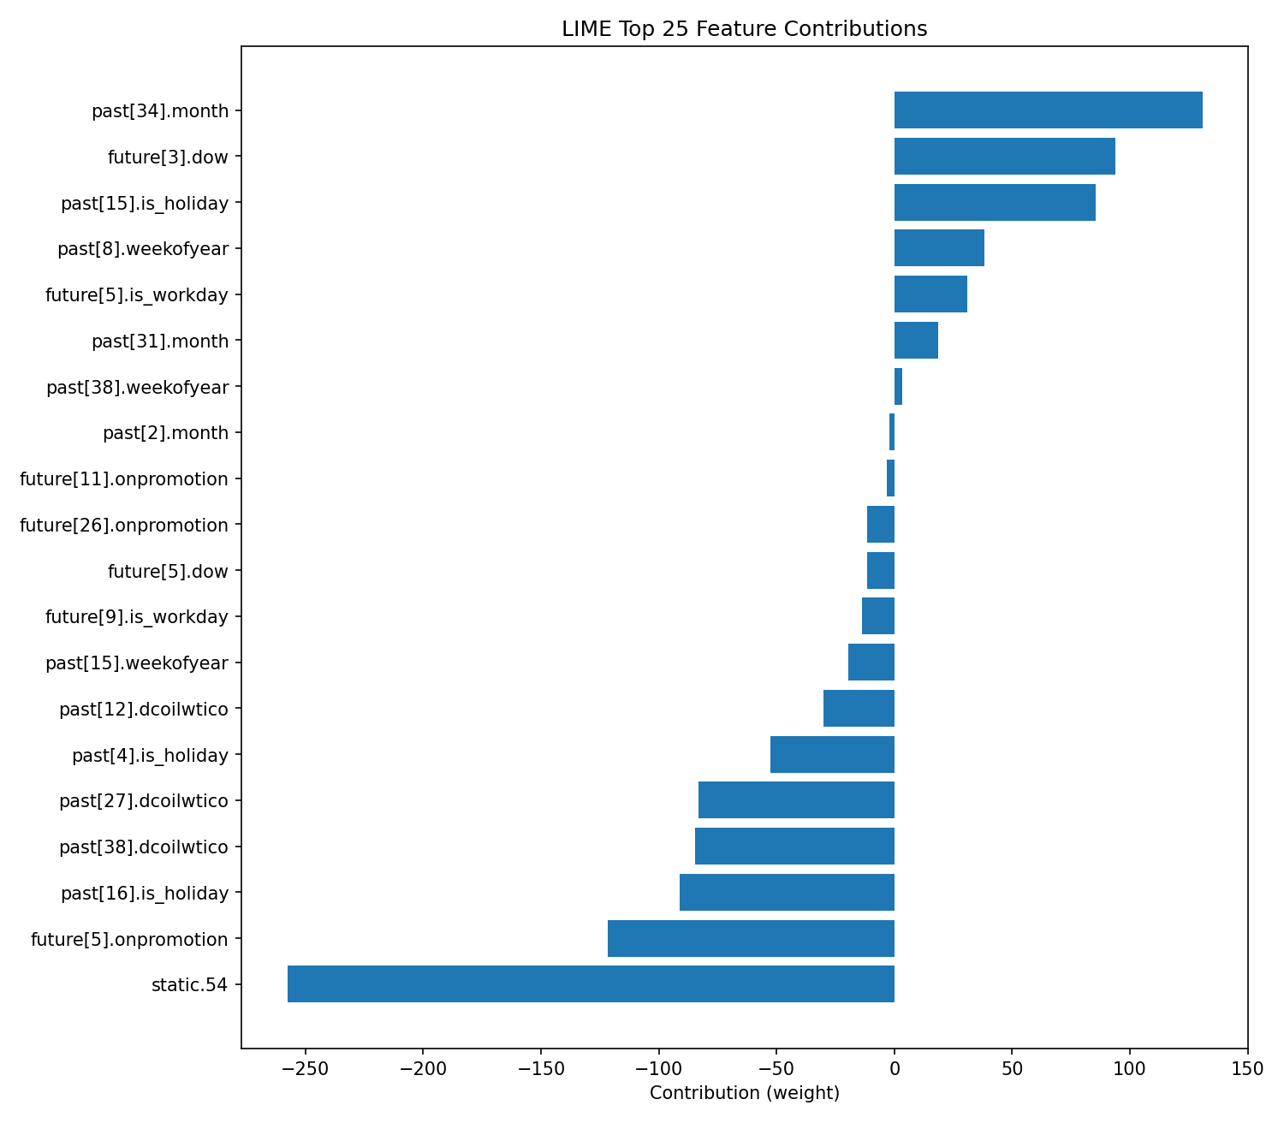
Hybrid XAI: LIME
Feature | Weight
past[34].month | 130.8142
future[3].dow | 93.7328
past[15].is_holiday | 85.4226
past[8].weekofyear | 38.0508
future[5].is_workday | 31.0180
past[31].month | 18.6158
past[38].weekofyear | 3.4062
past[2].month | -2.2726
future[11].onpromotion | -3.1617
future[26].onpromotion | -11.6736
future[5].dow | -11.7301
future[9].is_workday | -13.8870
past[15].weekofyear | -19.5332
past[12].dcoilwtico | -30.0725
past[4].is_holiday | -52.7784
past[27].dcoilwtico | -83.1999
past[38].dcoilwtico | -84.6973
past[16].is_holiday | -91.2767
future[5].onpromotion | -121.6794
static.54 | -257.7340

Slide 28
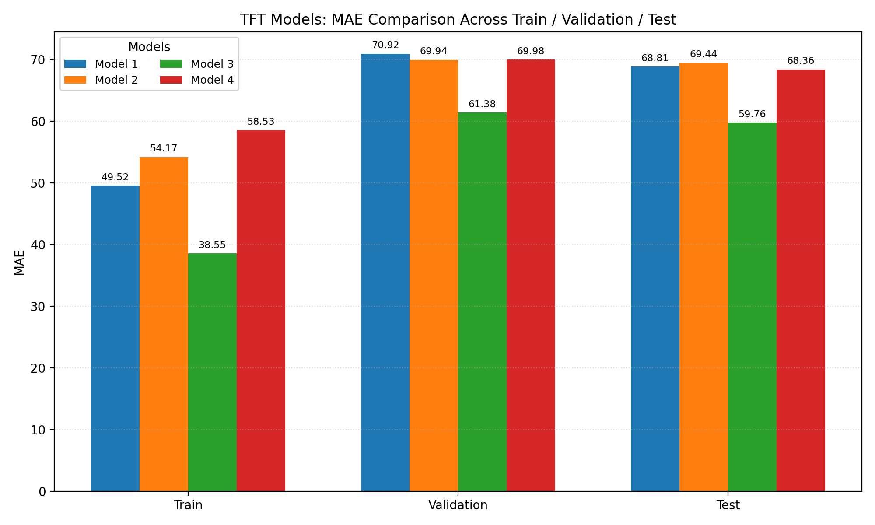
Hybrid Model Performance
Parameters
--hidden-dim: 128 --d-mode: 64 --heads: 4 --lstm-hidden: 64 --lstm-layers: 1 --gnn-hidden: 64 --gnn-embed: 32
--hidden-dim: 64 --d-mode: 32 --heads: 4 --lstm-hidden: 32 --lstm-layers: 1 --gnn-hidden: 32 --gnn-embed: 16
--hidden-dim: 256 --d-model: 128 --heads: 8 --lstm-hidden: 64 --lstm-layers: 3 --gnn-hidden: 128 --gnn-embed: 64
--hidden-dim: 32 --d-model: 16 --heads: 2 --lstm-hidden: 32 --lstm-layers: 1 --gnn-hidden: 16 --gnn-embed: 8

Slide 29
Summary
The highest performance - Hybrid model with 59.76 MAE
Difference - (1) 1,6 from TFT (2) 1,55 difference from GNN
The highly impacting features - future promotion, holiday, oil price, product family type, transactions, month, day-of-week, holidays
The least impacting features - future workday, static metadata like state, cluster, family, store number, and the concatenated static features (node embeddings and static attributes)
Although the performance of the hybrid model was high using concatenated static features, XAI analysis showed that static features had the greatest negative impact on the results
Experimental evaluation of key structural parameters demonstrates that tuning hidden layer dimensions, embedding sizes, attention heads, and network depth can markedly impact the predictive accuracy

Slide 30
Thank you for your attention!
Q & A

